Slide 1

Data Mining – Meeting 8
Roi Yehoshua
Partially based on slides of Noam Koenigstein
The Open University

Slide 2
Agenda
Clustering Part I (Unit 10)

Slide 3
What is Cluster Analysis?
Cluster: a collection of data objects
Similar to one another within the same cluster
Dissimilar to the objects in other clusters
Cluster analysis
Finding similarities between data according to the characteristics found in the data and grouping similar data objects into clusters
Unsupervised learning: no predefined classes
Typical applications
As a stand-alone tool to get insight into data distribution
As a preprocessing step for other algorithms

Slide 4
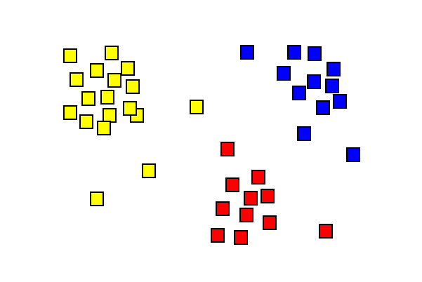
What is Cluster Analysis?
המטרה של האלגוריתם היא למצוא K מרכזי קבוצות, ושיוך של האיברים להן, המביא למינימום את סך המרחקים בין האיברים לבין מרכזי הקבוצות שלהם

Slide 5
Clustering: Rich Applications and Multidisciplinary Efforts
Pattern Recognition
Spatial Data Analysis
Image Processing
Economic Science (especially market research)
WWW: Document classification, cluster weblog data
Insurance: Identifying groups of motor insurance policy holders with a high average claim cost
City-planning: Identifying groups of houses according to their house type, value, and geographical location
Earth-quake studies: Observed earth quake epicenters should be clustered along continent faults

Slide 6
Requirements of Clustering in Data Mining
Scalability
Ability to deal with different types of attributes
Ability to handle dynamic data
Discovery of clusters with arbitrary shape
Minimal requirements for domain knowledge to determine input parameters
Able to deal with noise and outliers
Insensitive to order of input records
High dimensionality
Incorporation of user-specified constraints
Interpretability and usability

Slide 7
Quality: What Is Good Clustering?
A good clustering method will produce high quality clusters with
high intra-class similarity
low inter-class similarity
The quality of a clustering result depends on both the similarity measure used by the method and its implementation

Slide 8
Measure the Quality of Clustering
Dissimilarity/Similarity metric: Similarity is expressed in terms of a distance function, typically metric: d(i, j)
There is a separate “quality” function that measures the “goodness” of a cluster.
The definitions of distance functions are usually very different for interval-scaled, boolean, categorical, ordinal ratio, and vector variables.
Weights should be associated with different variables based on applications and data semantics.
It is hard to define “similar enough” or “good enough”
the answer is typically highly subjective.

Slide 9
Data Structures
Data matrix
(two modes)
Dissimilarity matrix
(one mode)

Slide 10
Type of data in clustering analysis
Interval-scaled variables
Binary variables
Nominal, ordinal, and ratio variables
Variables of mixed types

Slide 11
Interval-valued variables
Standardize data
Calculate the mean absolute deviation:
where
Calculate the standardized measurement (z-score)
Using mean absolute deviation is more robust than using standard deviation

Slide 12
Similarity and Dissimilarity Between Objects
Distances are normally used to measure the similarity or dissimilarity between two data objects
Some popular ones include: Minkowski distance:
where i = (x_{i1}, x_{i2}, …, x_{ip}) and j = (x_{j1}, x_{j2}, …, x_{jp}) are two p-dimensional data objects, and q is a positive integer
If q = 1, d is Manhattan distance

Slide 13
Similarity and Dissimilarity Between Objects (Cont.)
If q = 2, d is Euclidean distance:
Properties
d(i,j) ≥ 0
d(i,i) = 0
d(i,j) = d(j,i)
d(i,j) ≤ d(i,k) + d(k,j)
Also, one can use weighted distance, parametric Pearson product moment correlation, or other disimilarity measures

Slide 14




Example

Slide 15

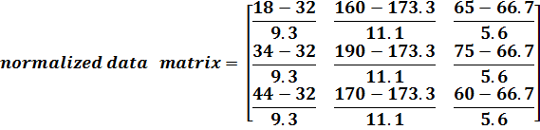

Cont.

Slide 16


Cont.

Slide 17
Binary Variables
Object j
A contingency table for binary data
Distance measure for symmetric binary variables:
Distance measure for asymmetric binary variables:
Jaccard coefficient (similarity measure for asymmetric binary variables):
Object i
17

Slide 18
Dissimilarity between Binary Variables
Example
gender is a symmetric attribute
the remaining attributes are asymmetric binary
let the values Y and P be set to 1, and the value N be set to 0

Slide 19
Nominal Variables
A generalization of the binary variable in that it can take more than 2 states, e.g., red, yellow, blue, green
Method 1: Simple matching
m: # of matches, p: total # of variables
Method 2: use a large number of binary variables
creating a new binary variable for each of the M nominal states

Slide 20
Ordinal Variables
An ordinal variable can be discrete or continuous
Order is important, e.g., rank
Can be treated like interval-scaled
replace x_{if} by their rank
map the range of each variable onto [0, 1] by replacing i-th object in the f-th variable by
compute the dissimilarity using methods for interval-scaled variables

Slide 21
Variables of Mixed Types
A database may contain all the six types of variables
symmetric binary, asymmetric binary, nominal, ordinal, interval and ratio
One may use a weighted formula to combine their effects
f is binary or nominal:
d_{ij}^{(f)} = 0 if x_{if} = x_{jf} , or d_{ij}^{(f)} = 1 otherwise
f is interval-based: use the normalized distance
f is ordinal or ratio-scaled
compute ranks r_{if} and
and treat z_{if} as interval-scaled

Slide 22
Major Clustering Approaches (I)
Partitioning approach:
Construct various partitions and then evaluate them by some criterion, e.g., minimizing the sum of square errors
Typical methods: k-means, k-medoids, CLARANS
Hierarchical approach:
Create a hierarchical decomposition of the set of data (or objects) using some criterion
Typical methods: Diana, Agnes, BIRCH, ROCK, CAMELEON
Density-based approach:
Based on connectivity and density functions
Typical methods: DBSACN, OPTICS, DenClue

Slide 23
Typical Alternatives to Calculate the Distance between Clusters
Single link: smallest distance between an element in one cluster and an element in the other, i.e., dis(K_{i}, K_{j}) = min(t_{ip}, t_{jq})
Complete link: largest distance between an element in one cluster and an element in the other, i.e., dis(K_{i}, K_{j}) = max(t_{ip}, t_{jq})
Average: avg distance between an element in one cluster and an element in the other, i.e., dis(K_{i}, K_{j}) = avg(t_{ip}, t_{jq})
Centroid: distance between the centroids of two clusters, i.e., dis(K_{i}, K_{j}) = dis(C_{i}, C_{j})
Medoid: distance between the medoids of two clusters, i.e., dis(K_{i}, K_{j}) = dis(M_{i}, M_{j})
Medoid: one chosen, centrally located object in the cluster

Slide 24
Centroid, Radius and Diameter of a Cluster (for numerical data sets)
Centroid: the “middle” of a cluster
Radius: square root of average distance from any point of the cluster to its centroid
Diameter: square root of average mean squared distance between all pairs of points in the cluster
24

Slide 25
Comparison Between Similarity Measures
Single-link clustering has a drawback known as the “chaining effect: A few points that form a bridge between two clusters cause the single-link clustering to unify these two clusters into one.
Average-link clustering may cause elongated clusters to split and for portions of neighboring elongated clusters to merge.
The complete-link clustering methods usually produce more compact clusters and more useful hierarchies than the single-link clustering methods, yet the single-link methods are more versatile.
25

Slide 26
Partitioning Algorithms: Basic Concept
Partitioning method: Construct a partition of a database D of n objects into a set of k clusters, s.t., min sum of squared distance
Given a k, find a partition of k clusters that optimizes the chosen partitioning criterion
Global optimal: exhaustively enumerate all partitions
Heuristic methods: k-means and k-medoids algorithms
k-means (MacQueen’67): Each cluster is represented by the center of the cluster
k-medoids or PAM (Partition around medoids) (Kaufman & Rousseeuw’87): Each cluster is represented by one of the objects in the cluster
26

Slide 27
The K-Means Clustering Method
Given k, the k-means algorithm is implemented in four steps:
Partition objects into k nonempty subsets
Compute seed points as the centroids of the clusters of the current partition (the centroid is the center, i.e., mean point, of the cluster)
Assign each object to the cluster with the nearest seed point
Go back to Step 2, stop when no more new assignment
27

Slide 28
The K-Means Clustering Method
Example
10
10
9
9
8
8
7
7
6
6
5
5
4
Assign each object to most similar center
Update the cluster means
4
3
3
2
2
1
1
0
0
0
1
2
3
4
5
6
7
8
9
10
0
1
2
3
4
5
6
7
8
9
10
reassign
reassign
K=2
Arbitrarily choose K objects as initial cluster centers
Update the cluster means

Slide 29
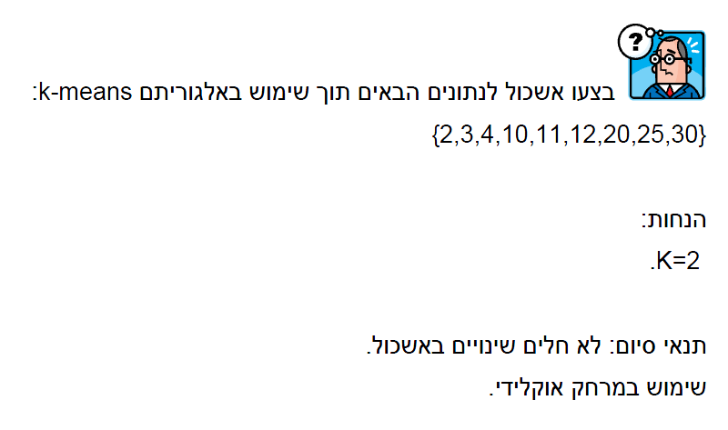
Example
29

Slide 30
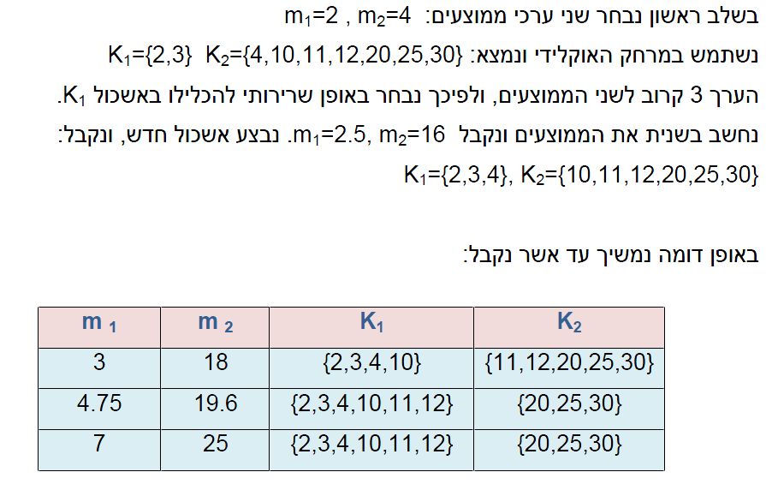
Cont.
30

Slide 31
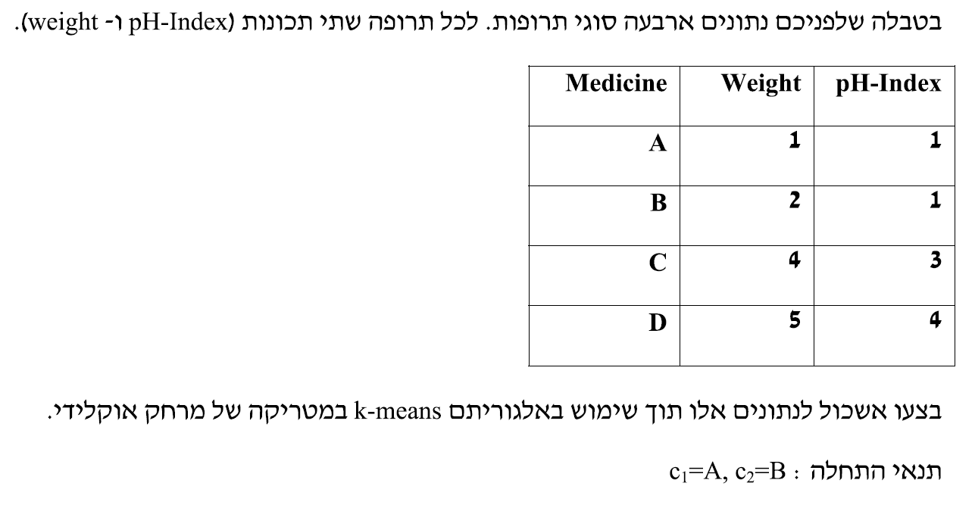
תרגיל
31

Slide 32
Comments on the K-Means Method
Strength: Relatively efficient: O(tkn), where n is # objects, k is # clusters, and t is # iterations. Normally, k, t << n.
Comparing: PAM: O(k(n-k)² ), CLARA: O(ks² + k(n-k))
Comment: Often terminates at a local optimum. The global optimum may be found using techniques such as: deterministic annealing and genetic algorithms
Weakness
Applicable only when mean is defined, then what about categorical data?
Need to specify k, the number of clusters, in advance
Unable to handle noisy data and outliers
Not suitable to discover clusters with non-convex shapes
32

Slide 33
What Is the Problem of the K-Means Method?
The k-means algorithm is sensitive to outliers !
Since an object with an extremely large value may substantially distort the distribution of the data.
K-Medoids: Instead of taking the mean value of the object in a cluster as a reference point, medoids can be used, which is the most centrally located object in a cluster.
10
10
9
9
8
8
7
7
6
6
5
5
4
4
33
3
3
2
2
1
1
0
0
1
2
3
4
5
6
7
8
9
10
0
0
1
2
3
4
5
6
7
8
9
10

Slide 34
PAM (Partitioning Around Medoids) (1987)
PAM (Kaufman and Rousseeuw, 1987), built in Splus
Use real object to represent the cluster
Select k representative objects arbitrarily
For each pair of non-selected object h and selected object i, calculate the total swapping cost TC_{ih}
For each pair of i and h,
If TC_{ih} < 0, i is replaced by h
Then assign each non-selected object to the most similar representative object
repeat steps 2-3 until there is no change
34

Slide 35
A Typical K-Medoids Algorithm (PAM)
Total Cost = 20
10
9
8
Arbitrary choose k objects as initial medoids
Assign each remaining object to nearest medoids
7
6
5
4
3
2
1
0
0
1
2
3
4
5
6
7
8
9
10
K=2
Randomly select a nonmedoid object,O_{ramdom}
Total Cost = 26
Do loop
Until no change
10
10
9
Compute total cost of swapping
9
Swapping O and O_{ramdom}
If quality is improved.
8
8
7
7
6
6
5
5
4
4
3
3
2
2
1
1
0
0
1
2
3
4
5
6
7
8
9
10
0
0
1
2
3
4
5
6
7
8
9
10

Slide 36
PAM Clustering: Total swapping cost TC_{ih}=∑_{j}C_{jih}
t
j
t
j
i
h
h
i
h
j
i
i
t
h
j
t
36

Slide 37
What Is the Problem with PAM?
Pam is more robust than k-means in the presence of noise and outliers because a medoid is less influenced by outliers or other extreme values than a mean
Pam works efficiently for small data sets but does not scale well for large data sets.
O(k(n-k)² ) for each iteration
where n is # of data,k is # of clusters
Sampling based method,
CLARA(Clustering LARge Applications)
37

Slide 38
Hierarchical Clustering
Use distance matrix as clustering criteria. This method does not require the number of clusters k as an input, but needs a termination condition
Step 0
Step 1
Step 2
Step 3
Step 4
agglomerative
(AGNES)
a
a b
b
a b c d e
c
c d e
d
d e
e
divisive
(DIANA)
38
Step 4
Step 3
Step 2
Step 1
Step 0

Slide 39
AGNES (Agglomerative Nesting)
Introduced in Kaufmann and Rousseeuw (1990)
Implemented in statistical analysis packages, e.g., Splus
Use the Single-Link method and the dissimilarity matrix.
Merge nodes that have the least dissimilarity
Go on in a non-descending fashion
Eventually all nodes belong to the same cluster

Slide 40
Dendrogram: Shows How the Clusters are Merged
Decompose data objects into a several levels of nested partitioning (tree of clusters), called a dendrogram.
A clustering of the data objects is obtained by cutting the dendrogram at the desired level, then each connected component forms a cluster.

Slide 41
תרגיל
בצעו אשכול לעשר הנקודות הבאות תוך שימוש באלגוריתם
Agglomerative Hierarchical Clustering .
{(1,2), (4,8), (3,9), (7,3),(4,3),(2,4),(5,2),(3,5),(2,5), (6,6)}
בתשובתכם הניחו:
פונקצית המרחק בין פריטים – מנהטן
פונקצית מרחק בין clusters – minimum distance
שימו לב,
בתשובתכם הדגימו את כל השלבים והגדירו את האשכולות
הסופיים .

Slide 42
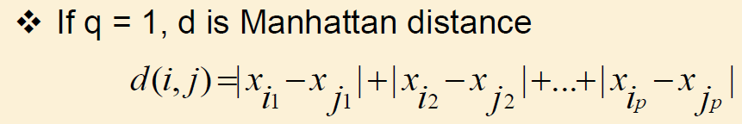
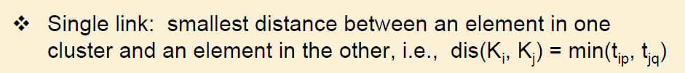
פתרון

Slide 43
פתרון
X2 | X1 | Point
2 | 1 | 1
8 | 4 | 2
9 | 3 | 3
3 | 7 | 4
3 | 4 | 5
4 | 2 | 6
2 | 5 | 7
5 | 3 | 8
5 | 2 | 9
6 | 6 | 10
Dist10 | Dist9 | Dist8 | Dist7 | Dist6 | Dist5 | Dist4 | Dist3 | Dist2 | Dist1 | Point
 |  |  |  |  |  |  |  |  |  | 1
 |  |  |  |  |  |  |  |  | 9 | 2
 |  |  |  |  |  |  |  | 2 | 9 | 3
 |  |  |  |  |  |  | 10 | 8 | 7 | 4
 |  |  |  |  |  | 3 | 7 | 5 | 4 | 5
 |  |  |  |  | 3 | 6 | 6 | 6 | 3 | 6
 |  |  |  | 5 | 2 | 3 | 9 | 7 | 4 | 7
 |  |  | 5 | 2 | 3 | 6 | 4 | 4 | 5 | 8
 |  | 1 | 6 | 1 | 4 | 7 | 5 | 5 | 4 | 9
 | 5 | 4 | 5 | 6 | 5 | 4 | 6 | 4 | 9 | 10

Slide 44
פתרון
Dist10 | Dist8 | Dist7 | Dist6,9 | Dist5 | Dist4 | Dist3 | Dist2 | Dist1 | Point
 |  |  |  |  |  |  |  |  | 1
 |  |  |  |  |  |  |  | 9 | 2
 |  |  |  |  |  |  | 2 | 9 | 3
 |  |  |  |  |  | 10 | 8 | 7 | 4
 |  |  |  |  | 3 | 7 | 5 | 4 | 5
 |  |  |  | 3 | 6 | 5 | 5 | 3 | 6,9
 |  |  | 5 | 2 | 3 | 9 | 7 | 4 | 7
 |  | 5 | 1 | 3 | 6 | 4 | 4 | 5 | 8
 | 4 | 5 | 3 | 5 | 6 | 6 | 4 | 9 | 10
6
9

Slide 45
פתרון
Dist10 | Dist7 | Dist 6,9,8 | Dist5 | Dist4 | Dist3 | Dist2 | Dist1 | Point
 |  |  |  |  |  |  |  | 1
 |  |  |  |  |  |  | 9 | 2
 |  |  |  |  |  | 2 | 9 | 3
 |  |  |  |  | 10 | 8 | 7 | 4
 |  |  |  | 3 | 7 | 5 | 4 | 5
 |  |  | 3 | 6 | 4 | 4 | 3 | 6,9,8
 |  | 5 | 2 | 3 | 9 | 7 | 4 | 7
 | 5 | 3 | 5 | 6 | 6 | 4 | 9 | 10
8
6
9

Slide 46
פתרון
10 | 7 | 6,9,8 | 5 | 4 | 2,3 | 1 | Point
 |  |  |  |  |  |  | 1
 |  |  |  |  |  | 9 | 2,3
 |  |  |  |  | 8 | 7 | 4
 |  |  |  | 3 | 5 | 4 | 5
 |  |  | 3 | 6 | 4 | 3 | 6,9,8
 |  | 5 | 2 | 3 | 7 | 4 | 7
 | 5 | 3 | 5 | 6 | 4 | 9 | 10
8
6
9
3
2

Slide 47
פתרון
10 | 6,9,8 | 5,7 | 4 | 2,3 | 1 | Point
 |  |  |  |  |  | 1
 |  |  |  |  | 9 | 2,3
 |  |  |  | 8 | 7 | 4
 |  |  | 3 | 5 | 4 | 5,7
 |  | 3 | 6 | 4 | 3 | 6,9,8
 | 3 | 5 | 6 | 4 | 9 | 10
8
6
9
3
2
5
7

Slide 48
פתרון
10 | 6,9,8 | 5,7,4 | 2,3 | 1 | Point
 |  |  |  |  | 1
 |  |  |  | 9 | 2,3
 |  |  | 3 | 3 | 5,7,4
 |  | 3 | 4 | 3 | 6,9,8
 | 3 | 5 | 4 | 9 | 10
8
6
9
3
2
5
7
4

Slide 49
פתרון
10 | 8 | 6,9,8 | 5,7,4,1 | 2,3 | Point
 |  |  |  |  | 2,3
 |  |  |  | 3 | 5,7,4,1
 |  |  | 3 | 4 | 6,9,8
 | 4 | 3 | 5 | 4 | 10
8
6
9
3
2
5
7
4
1

Slide 50
פתרון
6,9,8,10 | 5,7,4,1 | 2,3 | Point
 |  |  | 2,3
 |  | 3 | 5,7,4,1
 | 3 | 4 | 6,9,8,10
10
8
6
9
3
2
5
7
4
1

Slide 51
פתרון
6,9,8,10 | 5,7, 3,2,4,1 | Point
 |  | 5,7,3,2,4,1
 | 3 | 6,9,8,10
10
8
6
9
3
2
5
7
4
1

Slide 52
פתרון
10
8
6
9
3
2
5
7
4
1

Slide 53
DIANA (Divisive Analysis)
Introduced in Kaufmann and Rousseeuw (1990)
Implemented in statistical analysis packages, e.g., Splus
Inverse order of AGNES
Eventually each node forms a cluster on its own
53

Slide 54
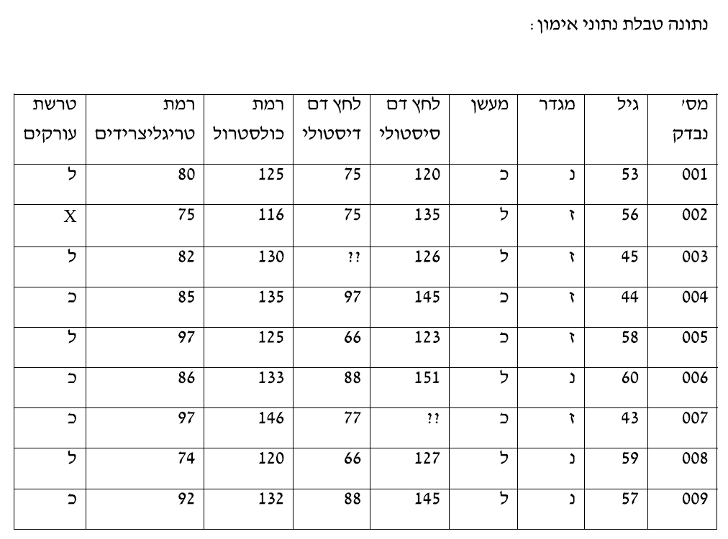
תרגיל

Slide 55
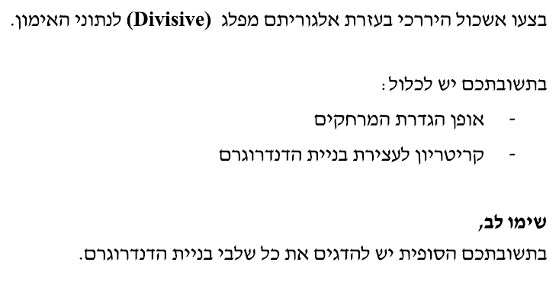
תרגיל

